Slide 1

Python Calculator Project
Project 2 • Basic, Advanced, Statistics & Graph calculator
NextHikes IT Solutions

Slide 2

Tools & Technologies
Python 3
Tkinter
Matplotlib
Core language: functions, classes, math, statistics modules
GUI: windows, buttons, labels, tabs (ttk.Notebook)
Draws the graph inside the calculator window
Visual Studio Code
GitHub
IDE used to write, run and debug the code
Version control and sharing the final code

Slide 3
Learning Outcomes
Core Python
tkinter Library
Visual Studio Code
Building a GUI with widgets, grid layout and events
Variables, loops, functions, classes, error handling
Running code, reading error messages, fixing bugs
GitHub
Application Development
Uploading the project and sharing a repository link
Planning and building a complete app step by step

Slide 4
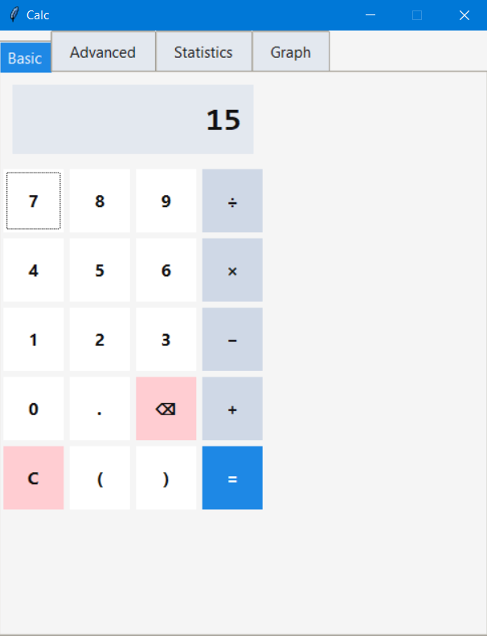
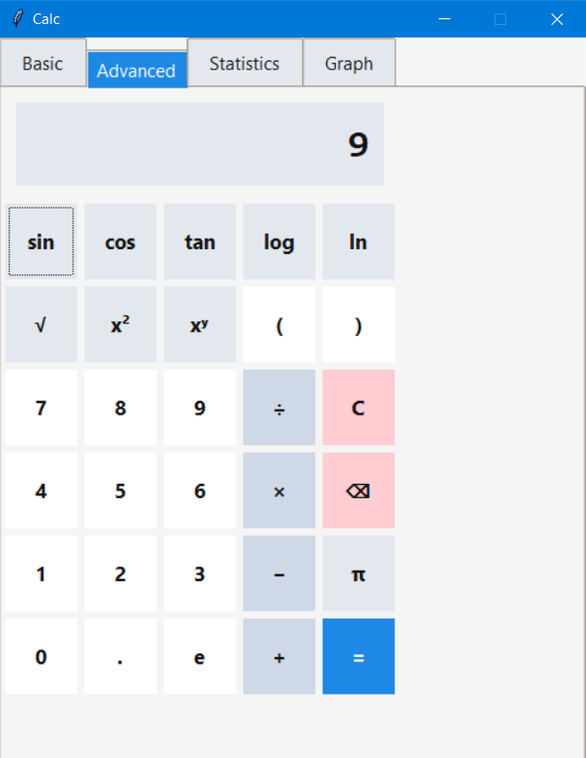
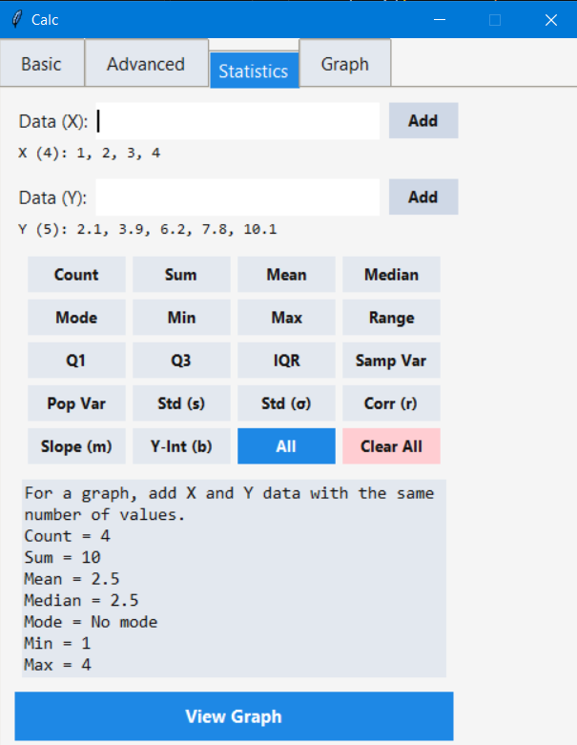
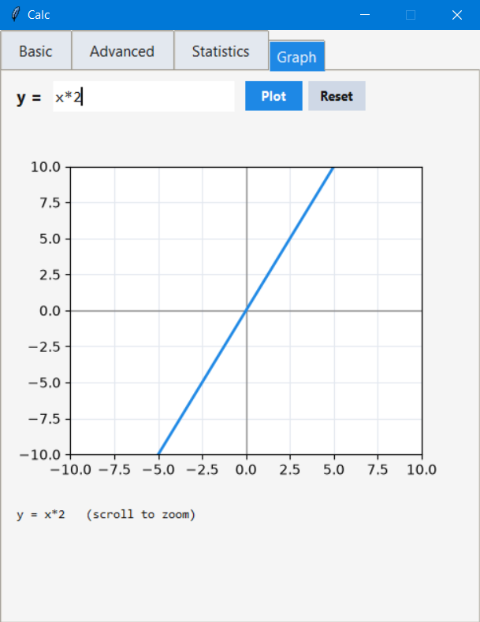
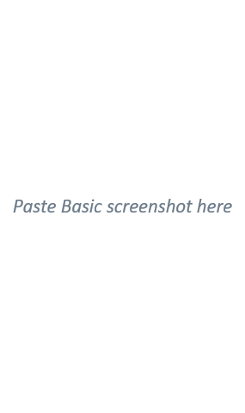
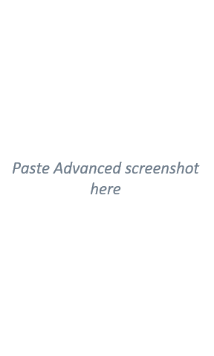
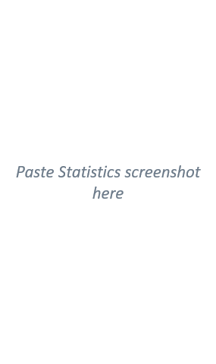
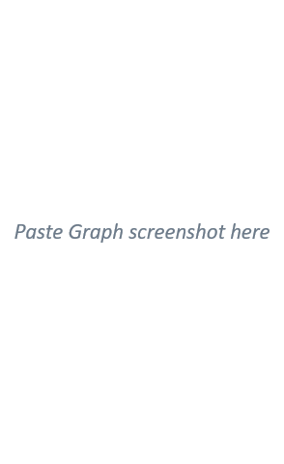




Project Output

Slide 5








Challenges & How I Solved Them
Syntax errors
Missing letters and spaces (mport, def__init__) stopped the app.
Fix: Read the error line number; check spelling and indentation.
eval() can run unsafe code; divide by zero crashed.
Fix: Keep every import at the top of the file.
Fix: Restricted names, no builtins, try / except.
Basic and Advanced tabs needed the same keypad logic.
matplotlib was missing; sin looked flat in degrees.
Too little data or X and Y of different length.
Fix: One Calculator class reused by both tabs.
Fix: Validate input and show clear messages.

Slide 6
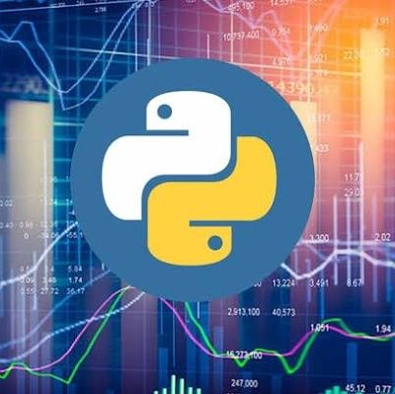
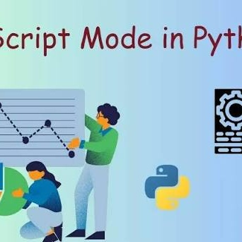
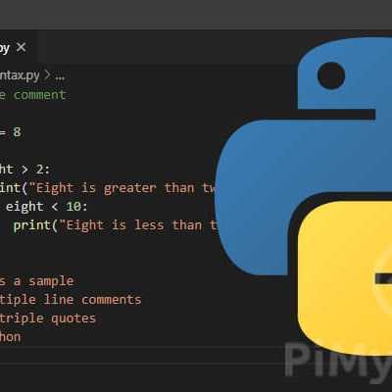
References
Python Software Foundation. Python 3 Documentation: docs.python.org/3
tkinter: Python interface to Tcl/Tk: docs.python.org/3/library/tkinter.html
statistics: mathematical statistics functions: docs.python.org/3/library/statistics.html
Matplotlib documentation: matplotlib.org/stable
Visual Studio Code documentation: code.visualstudio.com/docs
GitHub Docs: docs.github.com
NextHikes IT Solutions. Project 2: Building Basic Calculator (project brief)

Slide 7

Thank you
Soumik Ghosh
Intern
soumikg523@gmail.com
6289637992

